Slide 1
Math 769: Statistical Learning

Slide 2
Subset Selection
Shahrzad Jamshidi, PhD

Slide 3
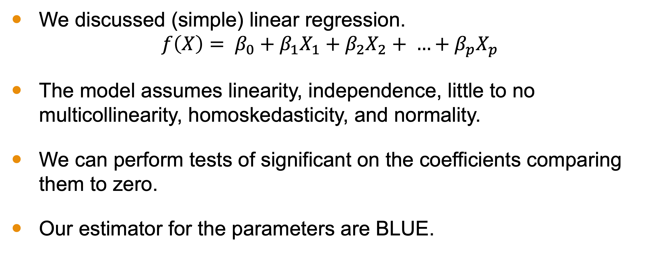
Last Time
We discussed (simple) linear regression.
$$f\left(X\right)= β_{0}+β_{1}X_{1}+β_{2}X_{2}+ …+β_{p}X_{p}$$
The model assumes linearity, independence, little to no multicollinearity, homoskedasticity, and normality.
We can perform tests of significant on the coefficients comparing them to zero.
Our estimator for the parameters are BLUE.

Slide 4
Objectives
Describe subset selection and its three main techniques.
List strengths and weaknesses of the technique.
List methods for model evaluation with subset selection.
Define data snooping.

Slide 5
Issues with Simple Linear Regression
Real-world data often has multiple predictors.
Not all predictors are equally useful.
Challenge: How do we choose which predictors to include in our model?

Slide 6
Introducing Subset Selection
Subset Selection is a method for selecting a subset of independent variables to use in a regression model.
A method to eliminate unnecessary or uninformative variables
Aim: Find the best possible combination of predictors to enhance model accuracy while avoiding overfitting.

Slide 7
Advantages of Subset Selection
Relevance
Some predictors may not have a strong relationship with the response variable.
Avoids Overfitting
Including unnecessary predictors can make the model overly complex.
Interpretability
Simpler models are often easier to interpret and explain.

Slide 8
General Approach of Subset Selection
Input: a set of independent variables, dependent variables, and a method to evaluate the model.
Identify a subset of independent variables
Build a linear regression model with those variables.
Evaluate the model and store information.
Repeat: Return to step 1.
After a sufficient number of cases, return the best model.

Slide 9
Types of Subset Selection
Best Subset Selection: Consider all possible models with all combinations of predictors.
Forward Stepwise Selection: Start with no predictors and add one at a time.
Backward Stepwise Selection: Start with all predictors and remove one at a time.

Slide 10
Best Subset Selection
Evaluate all possible combinations of predictors.
For each combination, fit a model and assess its quality.
Pros: Thorough and finds the best combination.
Cons: Computationally *VERY* expensive for many predictors.

Slide 11
Forward Stepwise Selection
Begin with an intercept, no predictors.
Add predictor that gives most significant improvement.
Repeat until a stopping criterion is met.
Pros: More efficient than best subset selection.
Cons: Might not find the global best set.

Slide 12
Backwards Stepwise Selection
Start with all predictors.
Remove the least impactful predictor.
Repeat until a stopping criterion is met.
Pros: Useful when the number of predictors is large.
Cons: Might not find the global best set. Can only be used when number of samples is greater than number of predictors.

Slide 13
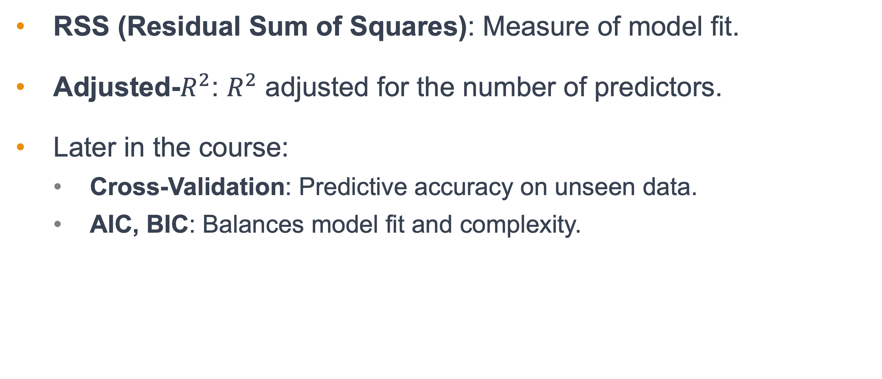
Criteria for Model Selection
RSS (Residual Sum of Squares): Measure of model fit.
Adjusted-$R^{2}$: $R^{2}$ adjusted for the number of predictors.
Later in the course:
Cross-Validation: Predictive accuracy on unseen data.
AIC, BIC: Balances model fit and complexity.

Slide 14
Challenges with Subset Selection
Requires careful choice of criteria.
Can be computationally intensive, especially with many predictors.
Risk of data snooping
Data snooping is a form of statistical bias manipulating data or analysis to artificially get statistically significant results.

Slide 15
Conclusion
Subset selection is a technique for picking the most explanatory independent variables from a set of possible variables.
There are three main approaches:
Best Subset Selection
Forward Stepwise Selection
Backward Stepwise Selection
It prevents the model from being overly complex; however, it is computationally expensive to do and risks data snooping.

